Slide 1
What excites you?
Luke 19:28-44

Slide 2
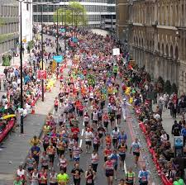
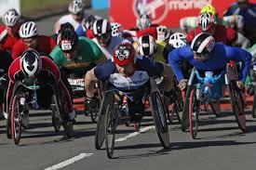
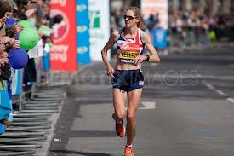
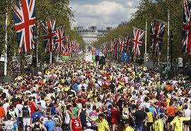
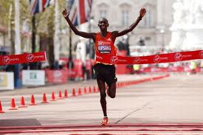

Slide 3
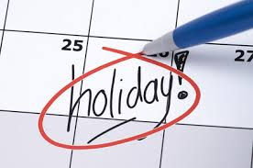
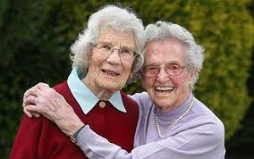
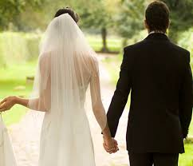
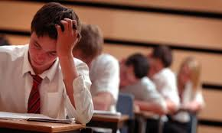

Slide 4
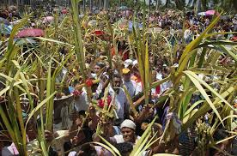
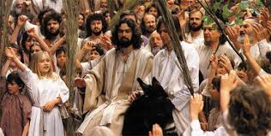

Slide 5
Isaiah 9:2-7
2 The people walking in darkness
have seen a great light;
on those living in the land of the shadow of death
a light has dawned.
3 You have enlarged the nation
and increased their joy;
they rejoice before you
as people rejoice at the harvest,
as men rejoice
when dividing the plunder.

Slide 6
4 For as in the day of Midian’s defeat,
you have shattered
the yoke that burdens them,
the bar across their shoulders,
the rod of their oppressor.
5 Every warrior’s boot used in battle
and every garment rolled in blood
will be destined for burning,
will be fuel for the fire.

Slide 7
6 For to us a child is born,
to us a son is given,
and the government will be on his shoulders.
And he will be called
Wonderful Counsellor, Mighty God,
Everlasting Father, Prince of Peace.
7 Of the increase of his government and peace
there will be no end.
He will reign on David’s throne
and over his kingdom,
establishing and upholding it
with justice and righteousness
from that time on and for ever.
The zeal of the Lord Almighty
will accomplish this.

Slide 8
Isaiah 11:1-10
A shoot will come up from the stump of Jesse;
from his roots a Branch will bear fruit.
2 The Spirit of the Lord will rest on him—
the Spirit of wisdom and of understanding,
the Spirit of counsel and of power,
the Spirit of knowledge and of the fear of the Lord—
3 and he will delight in the fear of the Lord.

Slide 9
He will not judge by what he sees with his eyes,
or decide by what he hears with his ears;
4 but with righteousness he will judge the needy,
with justice he will give decisions for the poor of the earth.
He will strike the earth with the rod of his mouth;
with the breath of his lips he will slay the wicked.
5 Righteousness will be his belt
and faithfulness the sash round his waist.

Slide 10
6 The wolf will live with the lamb,
the leopard will lie down with the goat,
the calf and the lion and the yearling together;
and a little child will lead them.
7 The cow will feed with the bear,
their young will lie down together,
and the lion will eat straw like the ox.
8 The infant will play near the hole of the cobra,
and the young child put his hand into the viper’s nest.
9 They will neither harm nor destroy
on all my holy mountain,
for the earth will be full of the knowledge of the Lord
as the waters cover the sea.

Slide 11
10 In that day the Root of Jesse will stand as a banner for the peoples; the nations will rally to him, and his place of rest will be glorious.

Slide 12
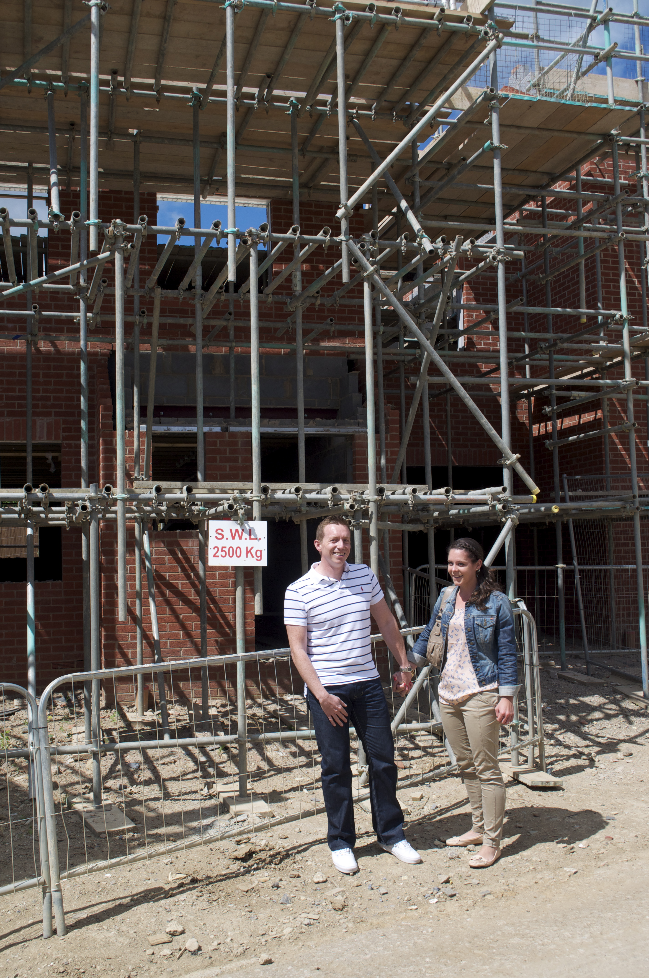
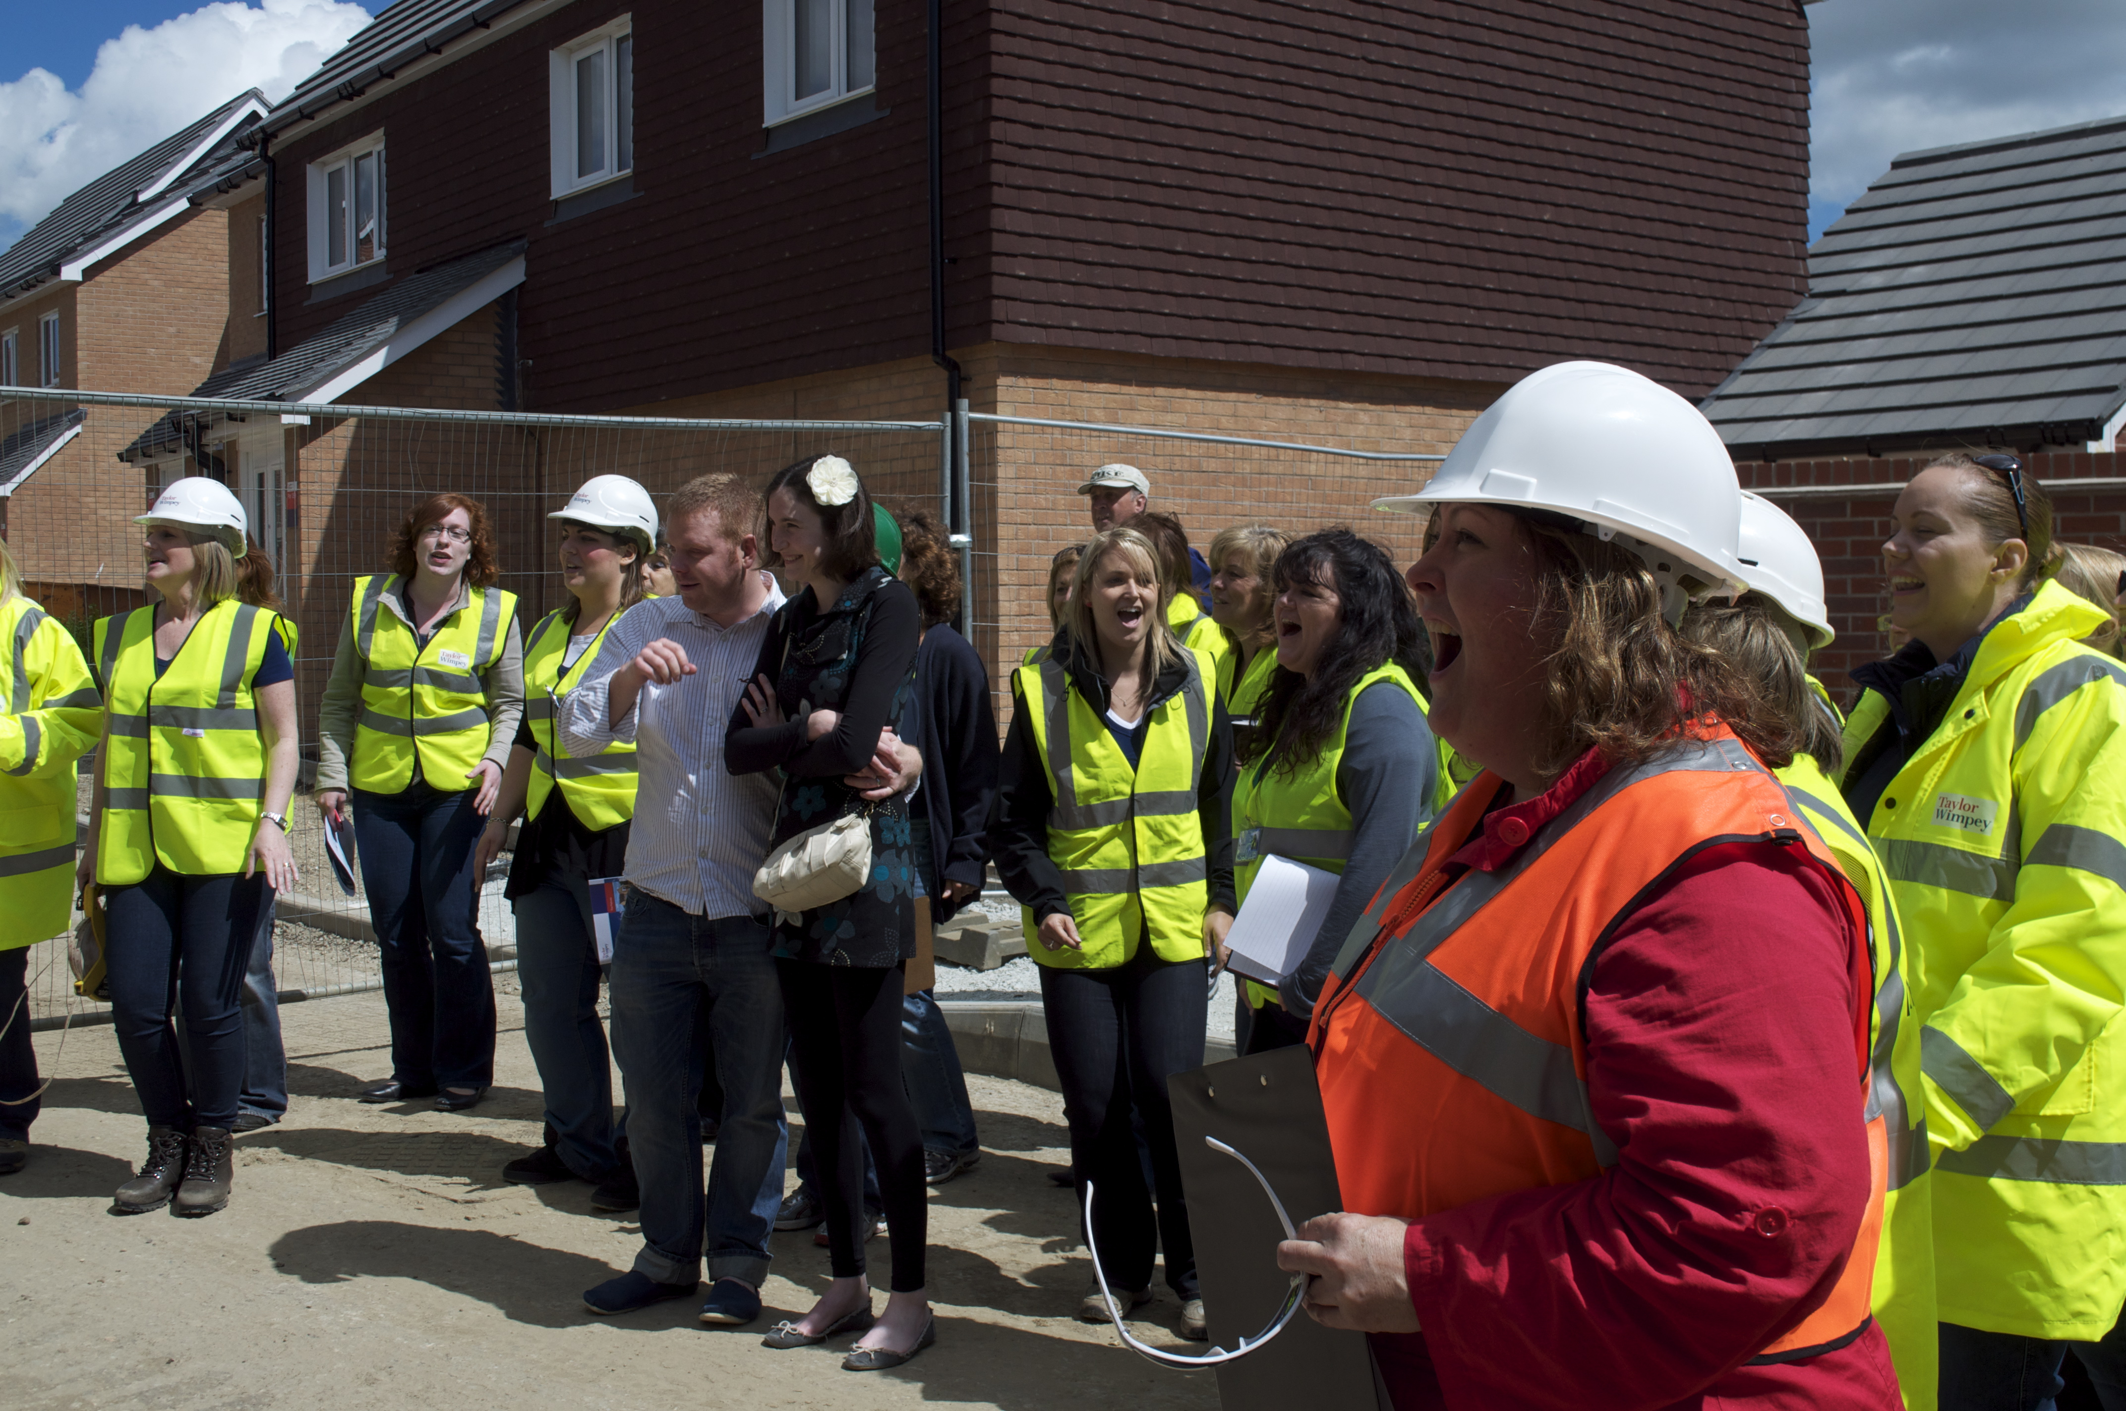

Slide 13
Luke 19
11 While they were listening to this, he went on to tell them a parable, because he was near Jerusalem and the people thought that the kingdom of God was going to appear at once.

Slide 14
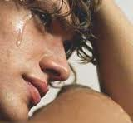

Slide 15
Isaiah 53:5
"He was pierced for our transgressions, he was crushed for our iniquities, the punishment that brought us peace was upon him, and by his wounds we have been healed. ... The Lord has laid on him the iniquity of us all."

Slide 16
